Slide 1
Introduction to Data Science Pipeline
Kunal Malhotra
kunal.malhotra1@ibm.com

Slide 2
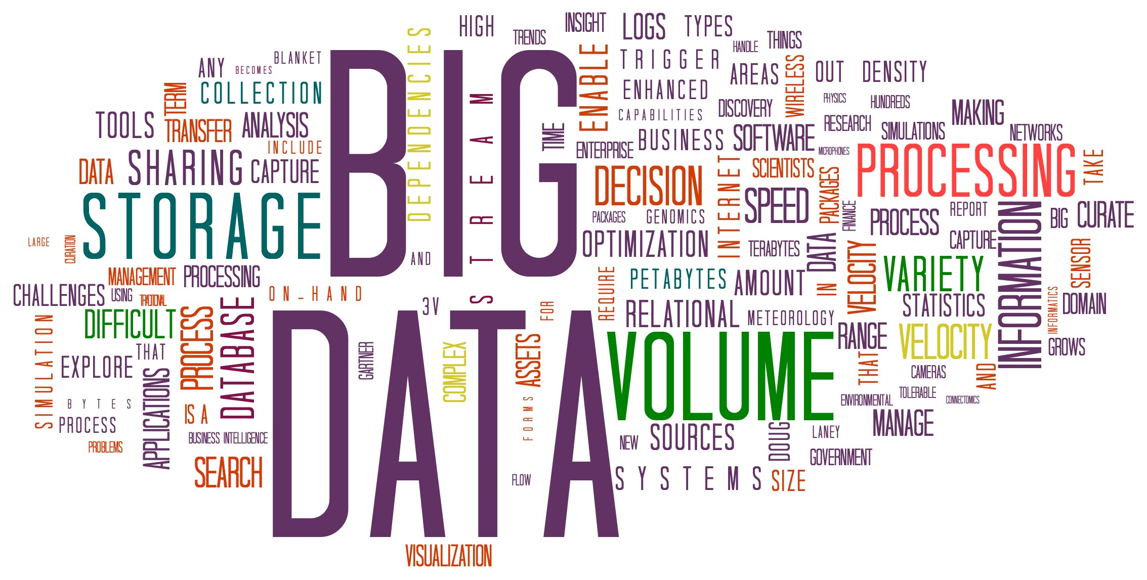
What is Data Science?
Extraction of knowledge from large volumes of data that are structured or unstructured.
It is a continuation of the fields data mining and predictive analytics

Slide 3
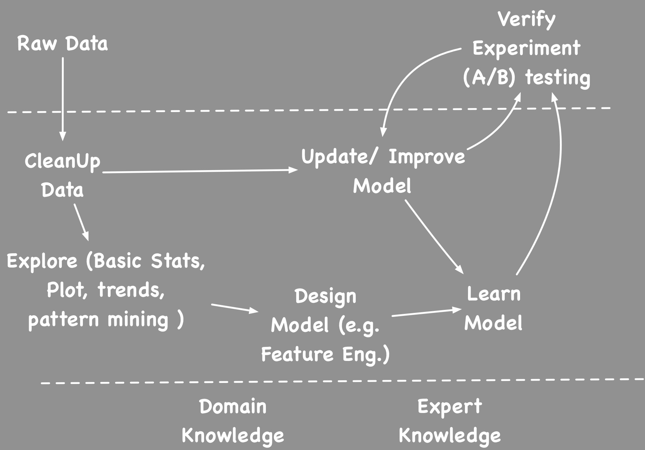
Data Science Pipeline

Slide 4
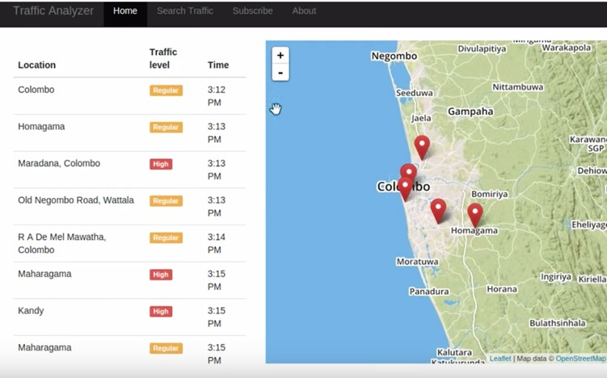
Example ( Road.lk) traffic Feed
Data as tweets
Extract time, location, and traffic level using NLP
Explore data
Model based on time, and it is a holiday
Predict traffic given a time and location.

Slide 5
Data Cleanup
Real data is messay, often needs to cleaned up before useful.
Bad formats - ignore or treat like missing data
Missing Data - extrapolate or remove data line
Useless variables - remove
Wrong data - e.g. aaa, bbb, joe, some might be deliberate lie, or 99 may be a code for N/A

Slide 6
Data Cleanup (Contd.)
Transform variables ( date formats, String to int)
Create derived variables
Derive country from IP
age from ID card number
Normalize strings
e.g. stemm or use phonetic sounds
different spellings and nicknames ( William->Bill)
Feature value re scaling (e.g. most ML algorithms needs value to rescaled to 0-1 range).
Enrich (e.g. lookup and add age from profile)

Slide 7
Data Exploration
Understand, and get a feel for what is expected (models => densities, constraints) and unexpected/ residuals (errors, outliers)
Think what this is data about? domain, background,
how it is collected, what each fields mean and range of values.
Head, tail, count, all descriptives (Mean, Max, median, percentiles .. ) - Five number Summary. Min. 1st Qu. Median Mean 3rd Qu. Max.
Run a bunch of count/group-by statements to gauge if I think it's corrupt.

Slide 8
Data Exploration (Contd.)
Plot - take random sample and explore ( scatter plot)
e.g. Draw scatter plot or Trellis Plot
Find Dependencies between fields
Calculate Correlation
Dimensionality reduction
Cluster and look visualize clusters
Look at frequency distribution of each field and try to find a known distribution if possible.

Slide 9
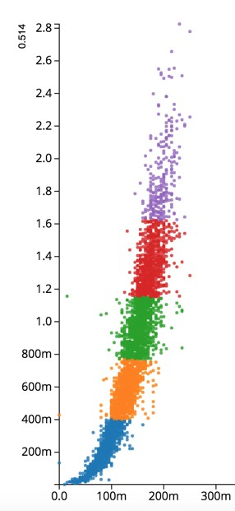
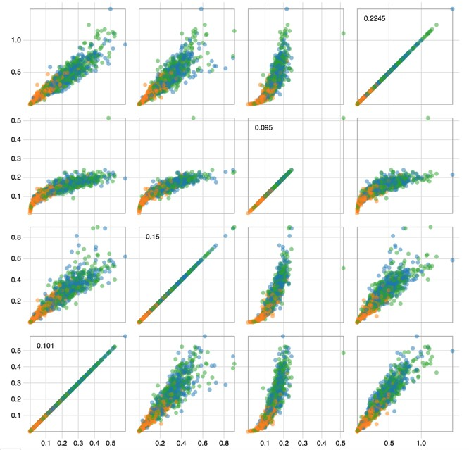
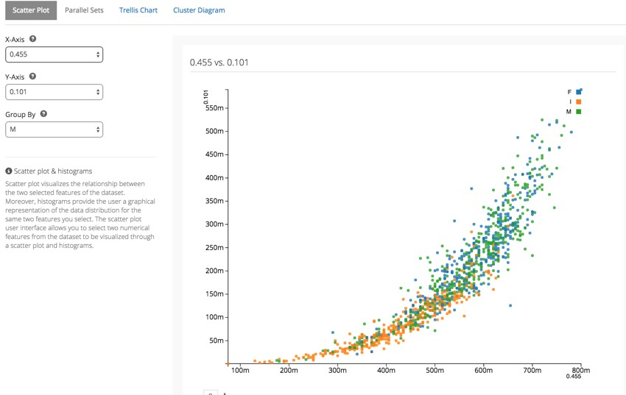
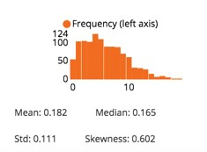
Data Exploration (Contd.)

Slide 10
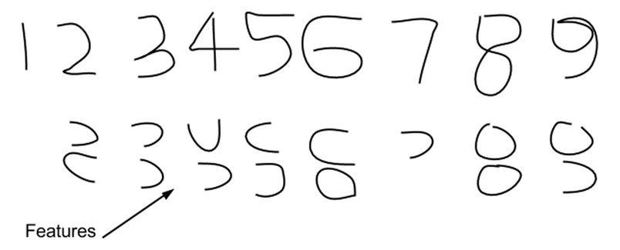
Feature Engineering
Feature engineering is the art of finding feature that leads simplest decision algorithm. ( Good features allow a simple model to beat a complex model.)
Best features may be a subset, or a combination, or transformed version of the features.

Slide 11
How to do Feature Engineering?
Manually pick by domain experts and trial and error.
Search the possible combinations by training and combining subsets (e.g. Random Forest)
Use statistical concepts like correlation and information criteria
Reduce the features to a low dimension space using techniques like PCA.
Automatic Feature Learning though Deep Learning

Slide 12
Analysis
Goal of analysis is to extract knowledge
This knowledge usually come in one of the two forms
KPI (Key Performance Indicators)
Describe key measurement for what is being measured. (e.g. revenue per year, profit margin, revenue for sqft in retail, revenue per employer)
Models to describe or predict the data
e.g. Machine Learning models or Statistical models

Slide 13
4 Analysis types by time to decision
Hindsight ( what happened?)
Done using Batch Analytics like MapReduce
Oversight ( what is happening?)
Done using Real Time Analytics technologies like CEP
Insight ( why things happening?)
Done with Data Mining and Unsupervised learning algorithms like Clustering
Foresight ( what will happen?)
Done by building models using Machine learning or one of other techniques

Slide 14
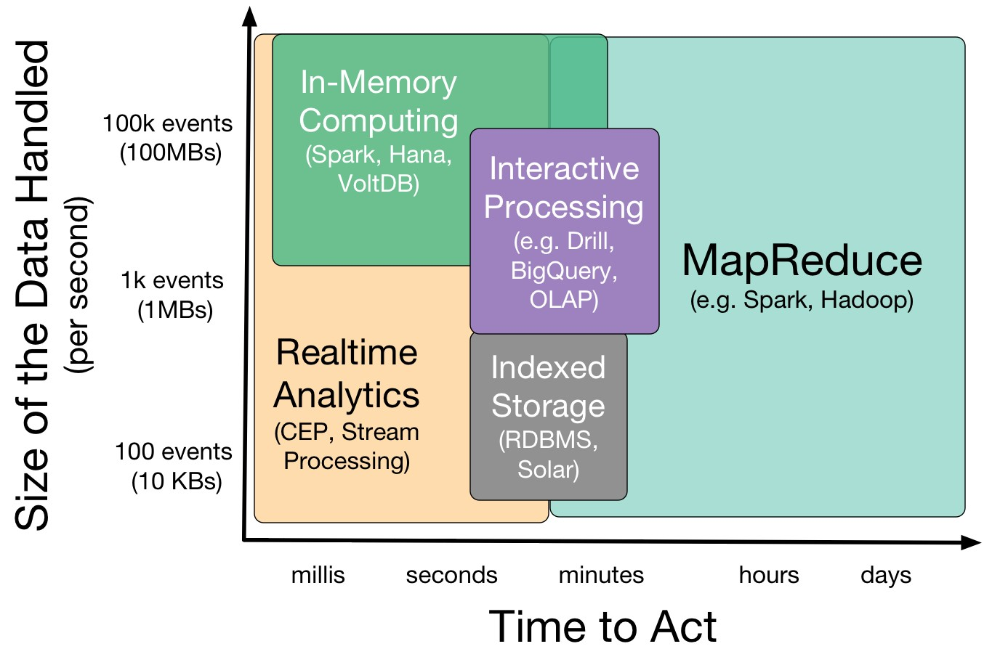
Data Analytics Tools Landscape

Slide 15
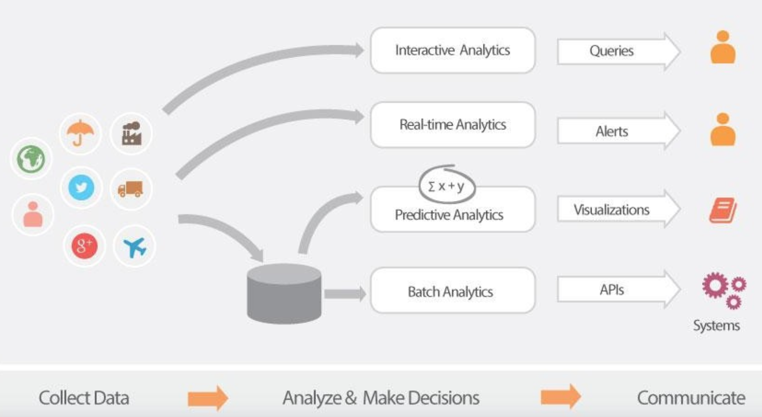

Slide 16
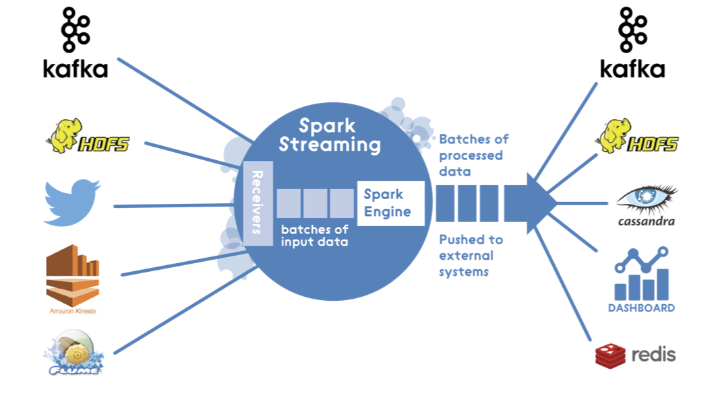
Batch Analytics

Slide 17
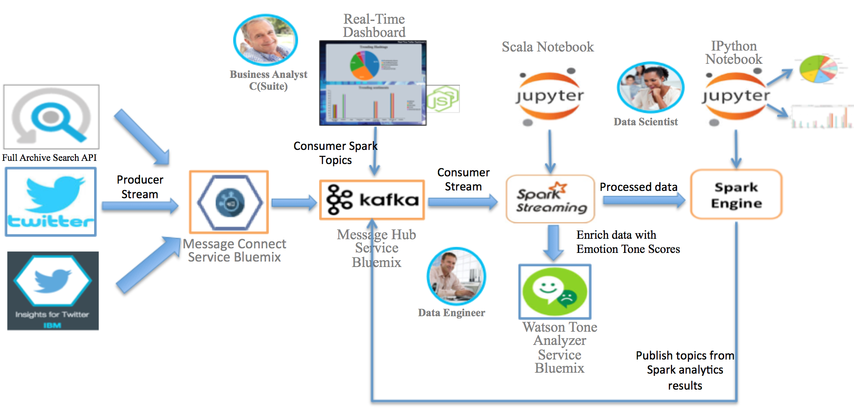
Real Time Analytics: Complex Event Processing

Slide 18
Building A Decision Model
A model describe how a system behave when input changes. There are many ways to build models.
Regression models and ML Models Time series models.
Statistical models.
Physical Models - based on physical phenomena. For example flight models, space flight models weather models.
Mathematical Models

Slide 19
Pitfalls: Experiment vs Observation
If you follow scientific method, you would do experiments, and they have control sets (A/B) tests.
Big Data does not have a control set, it is rather observations. (we observe the world as it happens)
So what we can tell are limited.
Correlation does not imply Causality!!
Send a book home example.
All big buyers have free shipping.

Slide 20

Causality: What can we do?
Option 1: We can act on correlation if we can verify the guess or if correctness is not critical (Start Investigation, Check for a disease, Marketing).
Option 2: We verify correlations using A/B testing or propensity analysis.

